Slide 1

ASSIGNMENT GUIDELINES
Make the changes in the PPT as you solve the parts
This file contains the template for the EDA part of the project.
Check the instructions added in the note section of every slide for clarity.
Don’t move around any image or text box
If you require more/lesser elements, be careful when you copy/delete the existing ones.

Slide 2
ASSIGNMENT Name: Kunal Kakara
Problem Statement
Bank of Corporate conducted a telemarketing campaign for one of its financial products, ‘Term deposits’, to build a long-term relationship with the existing customers. Your goal is to identify the target customers for the term deposits from the pool of the bank’s existing customers. You should also capture the key driving factors (or driver variables) behind the successful conversion of a customer, i.e., the customer opening a term deposit account with the bank.
Assignment Objective
To identify the target customers and the driving factors behind a successful customer conversion for future marketing campaigns.
Notes:
Problem Statement

Slide 3
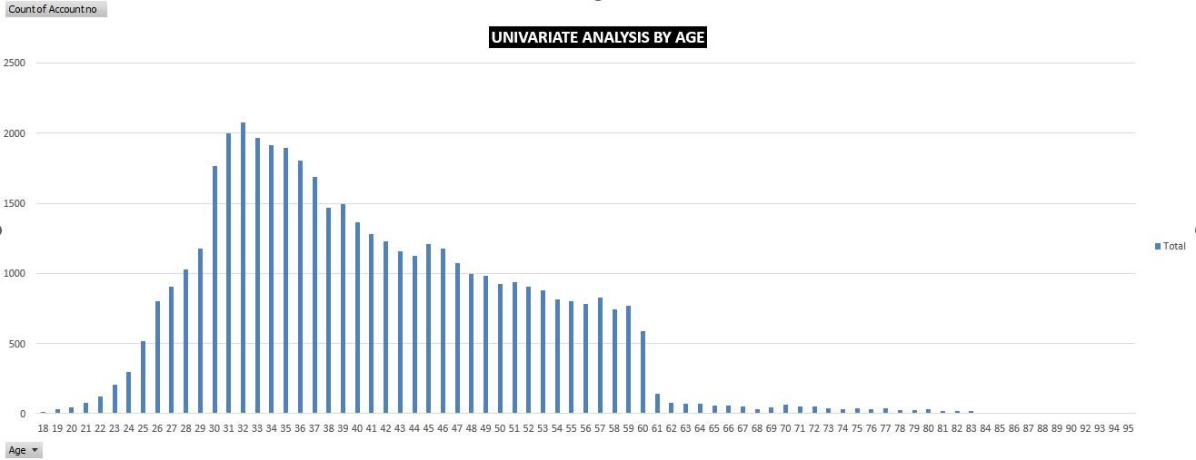
Univariate Analysis
Variable under consideration: By Age
Observation: The majority of the customers are aged 26 – 60 years which can also be considered a working age group. Also, there is a steep decline in the number of customers after age 60.
Notes:
Mention the results of the excel analysis and add the corresponding visualisations to the space provided above. Use copies of the above slide if necessary.

Slide 4
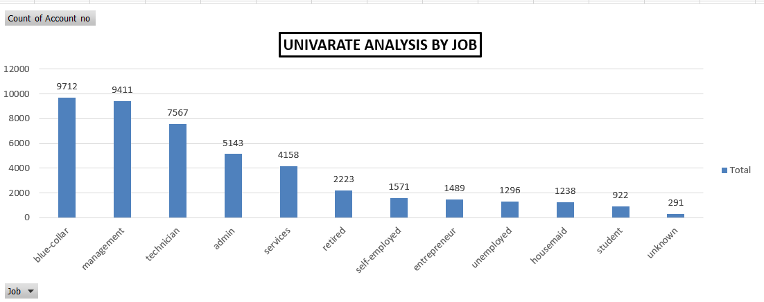
Univariate Analysis
Variable under consideration: By Job
Observation: Jobs with blue-collar, management, technician, admin, and service are the major targeted customers by the bank.
Notes:
Mention the results of the excel analysis and add the corresponding visualisations to the space provided above. Use copies of the above slide if necessary.

Slide 5
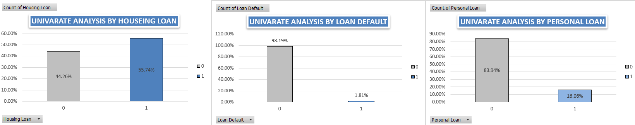
Univariate Analysis
Variable under consideration: By loan
Observation: People who have taken a housing loan and have not defaulted are most likely to be considered for the term Deposit plan. Very few people opt for a personal loan.
Notes:
Mention the results of the excel analysis and add the corresponding visualisations to the space provided above. Use copies of the above slide if necessary.

Slide 6
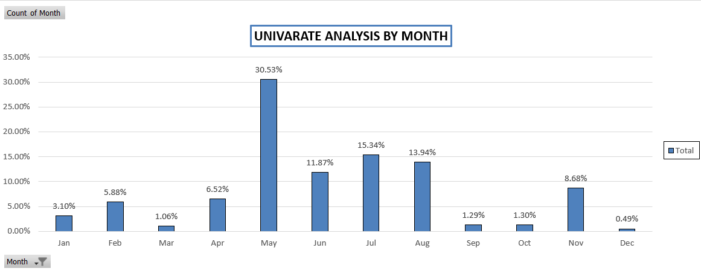
Univariate Analysis
Variable under consideration: By Month
Observation: The majority of the customers were approached in the month of May.
Notes:
Mention the results of the excel analysis and add the corresponding visualisations to the space provided above. Use copies of the above slide if necessary.

Slide 7
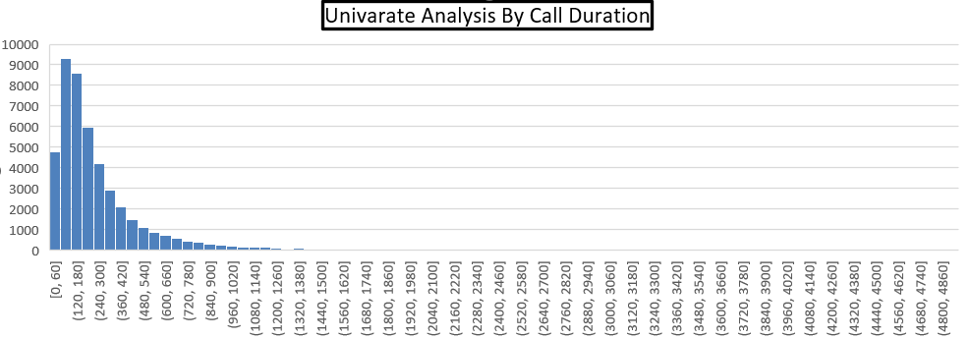
Univariate Analysis
Observation: The Graph Shows th.at the call duration with most of the customers lies between 1-3 Mins

Slide 8
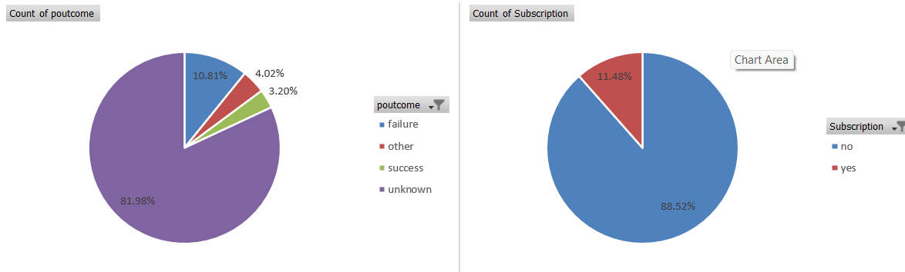
Segmented Univariate Analysis
Observation: Poutcome indicates that nearly 82% of the people have been not reached so far.
Observation: The conversion rate of the customer is 12% for the subscription of the term deposit.

Slide 9
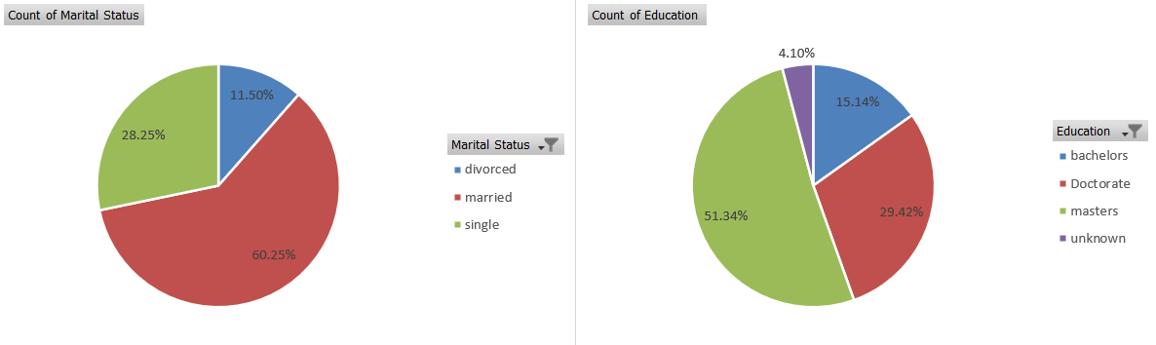
Segmented Univariate Analysis
Observation: Most of the customers are married or single.
Observation: The least customers hold a degree is a bachelor’s degree which is nearly 15%.

Slide 10
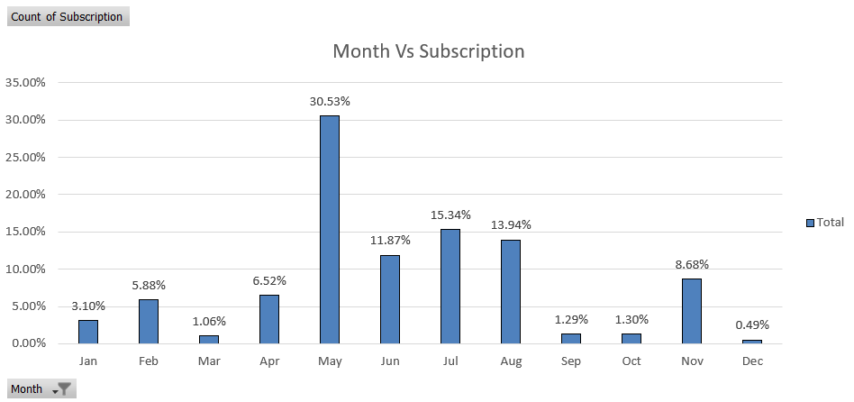
Bivariate Analysis
Variables under consideration: By Month Vs Subscription
Observation: As the graph indicates People tend to invest once the financial year ends and therefore customers should be contacted in the month of May.
Notes:
Mention the results of the excel analysis and add the corresponding visualisations to the space provided above. Use copies of the above slide if necessary.

Slide 11
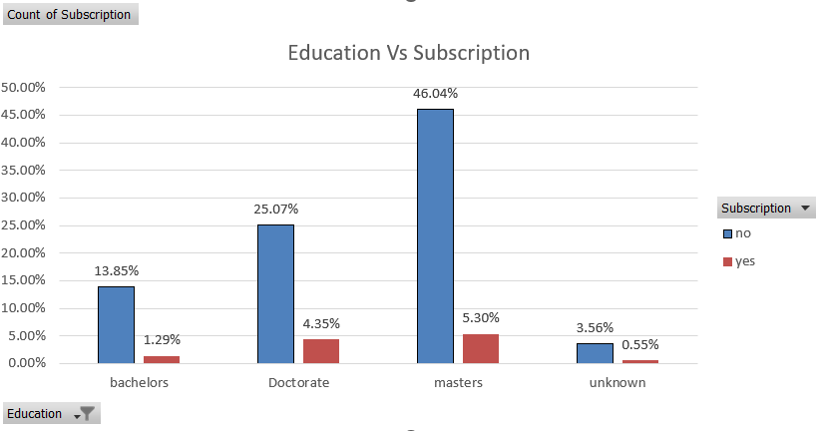
Bivariate Analysis
Variables under consideration: Education Vs Subscription
Observation: The Customers with Doctorate Degrees and Masters are the most targeted Segment and said yes to the subscription.
Notes:
Mention the results of the excel analysis and add the corresponding visualisations to the space provided above. Use copies of the above slide if necessary.

Slide 12
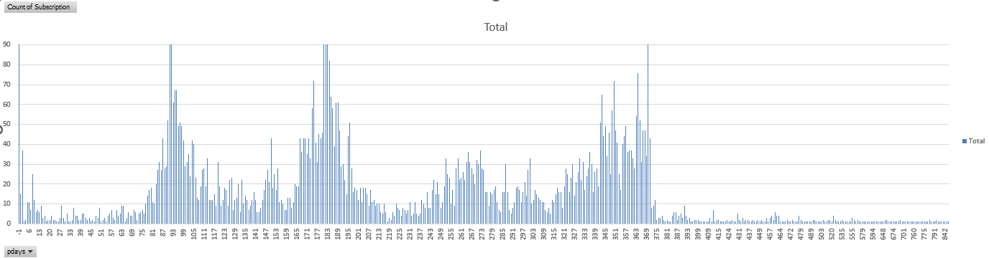
Bivariate Analysis
Variables under consideration: Pday Vs Subscription
Observation: People responded very well when contact after a Quarter or after a certain period.
Notes:
Mention the results of the excel analysis and add the corresponding visualisations to the space provided above. Use copies of the above slide if necessary.

Slide 13
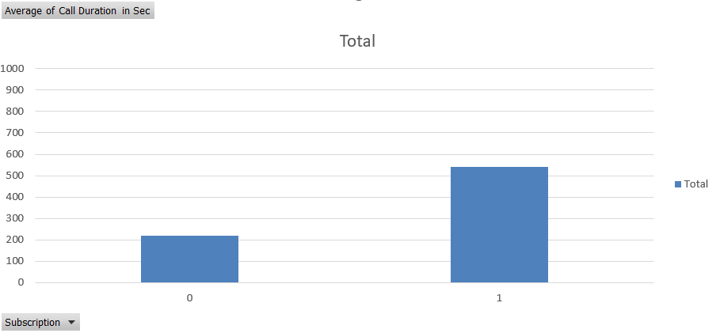
Bivariate Analysis
Variables under consideration: Call Duration vs. Subscription
Observation: The average Call Duration of the Subscribed Customer is more than the unsubscribed Customer.
Notes:
Mention the results of the excel analysis and add the corresponding visualisations to the space provided above. Use copies of the above slide if necessary.

Slide 14
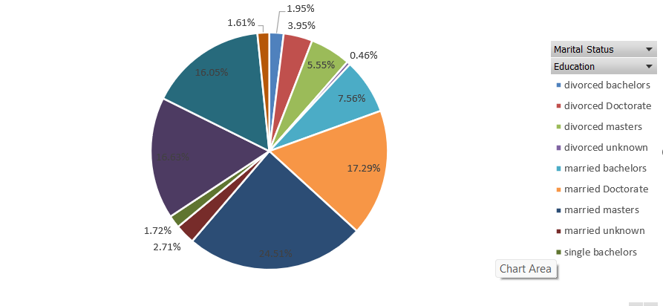
Major insights
Observation: Married Customers with master’s degrees are one of the most target segments that say yes to the Term Deposit Plan.

Slide 15
Major insights
Univariate Analysis:
Customers whose age lies between 26 – 60 have the most of the working segment and have an account with the bank.
Jobs like blue-collar, management, technician, admin, and service are the majority of the Bank Account Holder
Customers with housing loans and who have not defaulted are likely to consider the Term deposit Plan.
Customers should be contacted after the end of the financial year and the call duration is approximately 3 min per customer.

Slide 16
Major insights
Segmented Univariate
Nearly 82% percent of the people are never approached.
The subscription conversion rate is nearly 11%.
Most of the bank customers are single or married.
The customers with masters degree are the most.

Slide 17
Major insights
Bivariate Analysis
Customers with master’s and doctorate mostly say yes to the subscription.
Average call duration of the subscribed customers is more than unsubscribed
Customers should be contacted after a certain period rather than contacting frequently.

